Slide 1
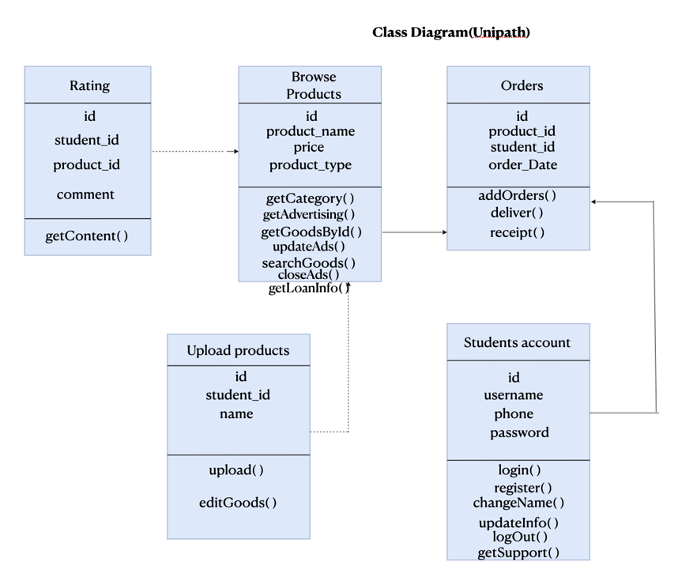

Slide 2

Sequence Diagram(Unipath)
Use Case 03.01 Post Ad
Ad sales representative
Use Case Scenario
This use case begins only when the actor logins and clicks on the Post Ad.
Actor needs to select an advertisement image which must be uploaded on the system.
The actor will click on the upload button to Post the Ad on the system.
The use case ends here.
Students Account
Browse Products
login()
getAdvertising()
logOut( )

Slide 3
Sequence Diagram(Unipath)
Use Case 03.02 Update Ad
Ad sales representative
Use Case Scenario
This use case begins when the actor logins and starts browsing through the ads page on the system.
The actor can choose the ad to be updated.
The actor can update and improve the product advertisement on the system.
The use case ends here.
Students Account
Browse Products
login()
updateAds()
closeAds()

Slide 4
Sequence Diagram(Unipath)
Use Case 03.03 Close Ad
Ad sales representative
Students Account
Browse Products
Use Case Scenario
This use case begins when Actor logs in and clicks the “Close Ad” button.
The system displays a list of ads posted by the actor that are active.
The actor clicks on the 'X' button to close the ad.
The use case ends here.
login()
closeAds()
UpdateAds（ ）

Slide 5
Sequence Diagram(Unipath)
Use Case 04.01 Provide document checklist
Use Case Scenario
1. The use case begins when Actor clicks the loan information button to open the document checklist available in the system.
2. System opens the documentation screen with links to available documents.
3. Actor selects a document and clicks on the link.
Company Name
Phone Number
Link
4. System redirects Actor to the selected loan provider website and this use case ends.
Students
Students Account
Browse Products
login()
getLoanInfo()
getLoanInfo()

Slide 6
Sequence Diagram(Unipath)
Use Case 04.02 Display loan recommendations
Use Case Scenario
1. The use case begins when Actor clicks the loan information button to open the document checklist available in the system.
2. System opens the documentation screen with links to available documents.
3. Actor selects a document and clicks on the link.
4. System redirects Actor to the selected loan provider website and this use case ends.
Students
Students Account
Browse Products
login()
getLoanInfo()
getLoanInfo()

